Slide 1
Number Systems
Seminar by Rhys Stever

Slide 2
Bases
Base 10- Decimal (0, 1, 2, 3, 4, 5, 6, 7, 8, 9)
Base 2- Binary (0 and 1)
Base 8- Octal (0, 1, 2, 3, 4, 5, 6, 7)
Base 16- Hexadecimal (0, 1, 2, 3, 4, 5, 6, 7, 8, 9, A, B, C, D, E, F)

Slide 3
Binary
“Base 2”: 1 and 0

Slide 4
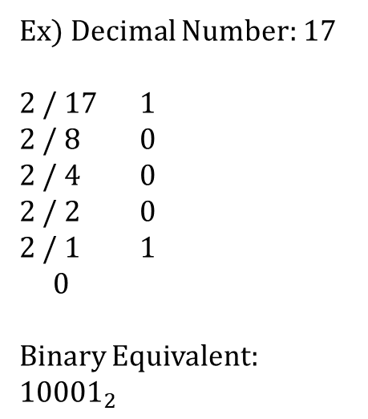
Decimal → Binary
Take the starting number and divide it by 2
Write the remainder to the right (1 or 0)
Write how many times it was divided below it
Take the number in Step 3 and do repeat steps 1-3 until the number is 0
“Read Up” all of the remainders
Ex) Decimal Number: 17
2 / 17 1
2 / 8 0
2 / 4 0
2 / 2 0
2 / 1 1
0
Binary Equivalent: ${10001}_{2}$

Slide 5
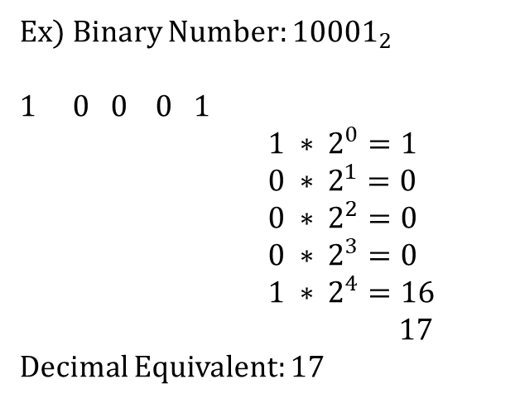

Binary → Decimal
Take each digit of the starting number and multiply it by $2^{n}$, where n is the place value
Add up all of the numbers
Ex) Binary Number: ${10001}_{2}$
0 0 0 1
${1 ∗ 2}^{0}=1$
$0 ∗ 2^{1}=0$
$0 ∗ 2^{2}=0$
$0 ∗ 2^{3}=0$
$1 ∗ 2^{4}=16$
$17$
Decimal Equivalent: 17

Slide 6
Octal
Octal | Binary
0 | 000
1 | 001
2 | 010
3 | 011
4 | 100
5 | 101
6 | 110
7 | 111
“Base 8”: 0, 1, 2, 3, 4, 5, 6, 7

Slide 7
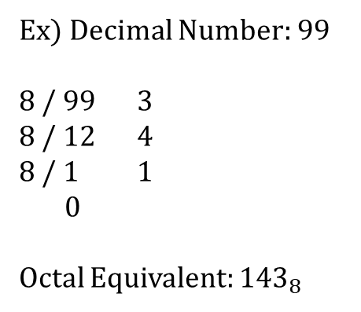
Decimal → Octal
Take the starting number and divide it by 8
Write the remainder to the right
Write how many times it was divided below it
Take the number in Step 3 and do repeat steps 1-3 until the number is 0
“Read Up” all of the remainders
Ex) Decimal Number: 99
8 / 99 3
8 / 12 4
8 / 1 1
0
Octal Equivalent: ${143}_{8}$

Slide 8
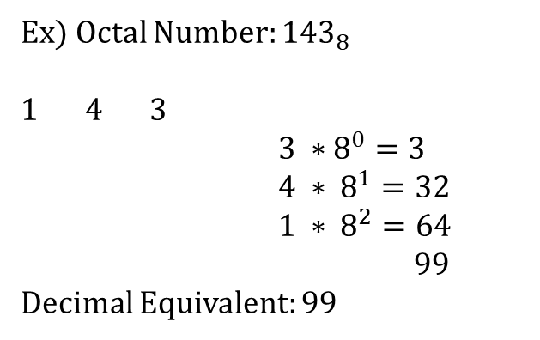

Octal → Decimal
Take each digit of the starting number and multiply it by $8^{n}$, where n is the place value
Add up all of the numbers
Ex) Octal Number: ${143}_{8}$
1 4 3
${3 ∗8}^{0}=3$
$4 ∗ 8^{1}=32$
$1 ∗ 8^{2}=64$
$99$
Decimal Equivalent: 99

Slide 9

Binary → Octal
Break the binary number into sets of 3 digits
Convert each of those sets into octal digits
Put each digit together to form the octal number
Binary Number: ${110011}_{2}$
1 1 0 0 1 1
110 011
6 3
Octal Equivalent: ${63}_{8}$

Slide 10
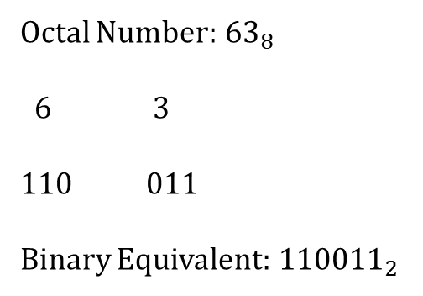
Octal → Binary
Take each digit and convert it to binary (will be a 3-digit set)
Put each digit’s binary equivalent together to form the binary number
Octal Number:${63}_{8}$
6 3
110 011
Binary Equivalent:${110011}_{2}$

Slide 11
Hexadecimal
Dec. | Hexa. | Binary | Dec. | Hexa. | Binary
0 | 0 | 0000 | 8 | 8 | 1000
1 | 1 | 0001 | 9 | 9 | 1001
2 | 2 | 0010 | 10 | A | 1010
3 | 3 | 0011 | 11 | B | 1011
4 | 4 | 0100 | 12 | C | 1100
5 | 5 | 0101 | 13 | D | 1101
6 | 6 | 0110 | 14 | E | 1110
7 | 7 | 0111 | 15 | F | 1111
“Base 16”: 0, 1, 2, 3, 4, 5, 6, 7,
8, 9, A, B, C, D, E, F

Slide 12
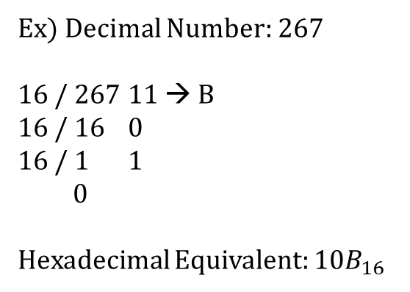
Decimal → Hexadecimal
A = 10 D = 13
B = 11 E = 14
C = 12 F = 15
Take the starting number and divide it by 16
Write the remainder to the right (*Remember to change any number 10-15 into the corresponding hexadecimal digit)
Write how many times it was divided below it
Take the number in Step 3 and do repeat steps 1-3 until the number is 0
“Read Up” all of the remainders
Ex) Decimal Number: 267
16 / 267 11 → B
16 / 16 0
16 / 1 1
0
Hexadecimal Equivalent: ${10B}_{16}$

Slide 13
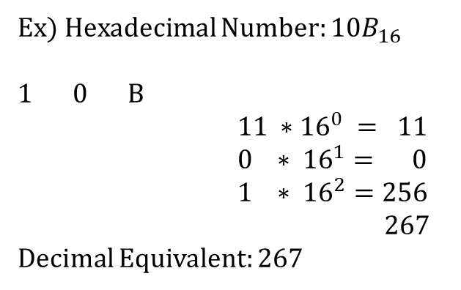

Hexadecimal → Decimal
A = 10 D = 13
B = 11 E = 14
C = 12 F = 15
Take each digit of the starting number and multiply it by ${16}^{n}$, where n is the place value
Add up all of the numbers
Ex) Hexadecimal Number: ${10B}_{16}$
1 0 B
${11 ∗16}^{0} = 11$
$0 ∗ {16}^{1}= 0$
$1 ∗ {16}^{2}=256$
$267$
Decimal Equivalent: 267

Slide 14
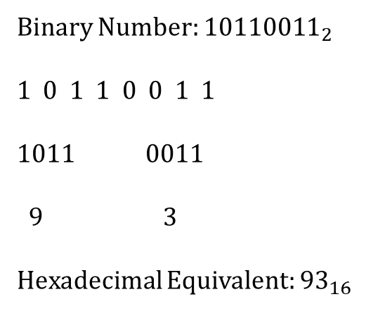
Binary → Hexadecimal
Split the binary number up into sets of 4 digits
Convert each set into the corresponding hexadecimal digit
Put each hexadecimal digit together
Binary Number: ${10110011}_{2}$
1 0 1 1 0 0 1 1
1011 0011
9 3
Hexadecimal Equivalent: ${93}_{16}$

Slide 15
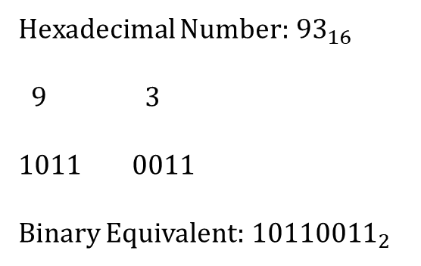
Hexadecimal → Binary
Take each hexadecimal digit and convert it to its 4-digit binary equivalent
Put all of the 4-digit binary sets together
Hexadecimal Number:${93}_{16}$
9 3
1011 0011
Binary Equivalent:${10110011}_{2}$

Slide 16
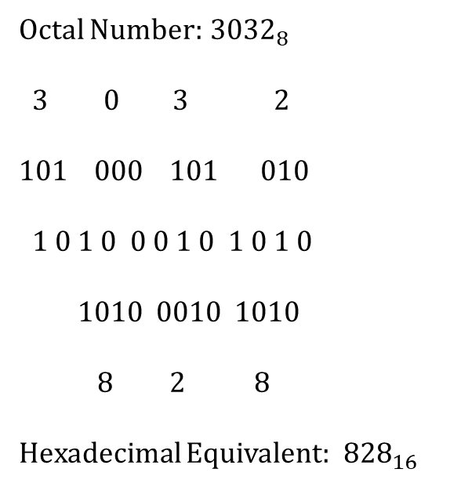
Octal → Hexadecimal
Convert the octal number into binary
Split the binary number up into sets of 4 digits
Convert each 4-digit set into the corresponding hexadecimal digit
Put all of the hexadecimal digits together
Octal Number:${3032}_{8}$
3 0 3 2
101 000 101 010
1 0 1 0 0 0 1 0 1 0 1 0
1010 0010 1010
8 2 8
Hexadecimal Equivalent:${ 828}_{16}$

Slide 17
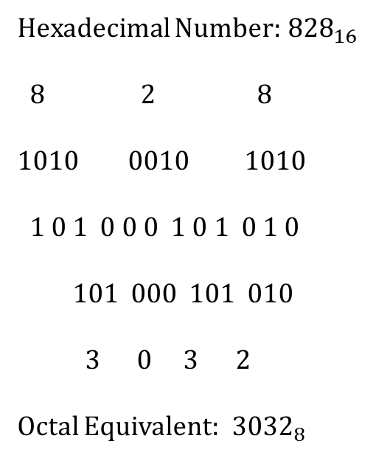
Hexadecimal → Octal
Reverse of Octal → Hexadecimal
Convert each hexadecimal digit into binary
Put each 4-digit set together
Split the binary number into sets of 3 digits
Convert each 3-digit set into octal
Put each octal digit together
Hexadecimal Number:${828}_{16}$
8 2 8
1010 0010 1010
1 0 1 0 0 0 1 0 1 0 1 0
101 000 101 010
3 0 3 2
Octal Equivalent:${ 3032}_{8}$

Slide 18
Operators

Slide 19
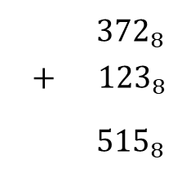
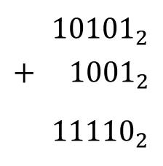
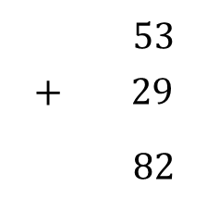
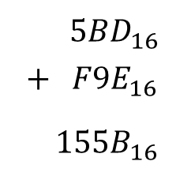
Addition
$53$
$$+ 29$$
$82$
${10101}_{2}$
$$+ {1001}_{2}$$
${11110}_{2}$
${372}_{8}$
$$+ {123}_{8}$$
${515}_{8}$
${ 5BD}_{16}$
$$+ {F9E}_{16}$$
${ 155B}_{16}$

Slide 20
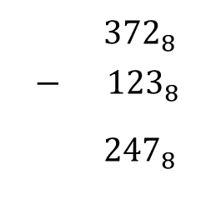
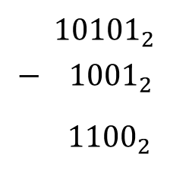

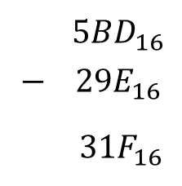
Subtraction
$53$
$$− 29$$
$24$
${ 10101}_{2}$
$$− {1001}_{2}$$
${ 1100}_{2}$
${372}_{8}$
$$− {123}_{8}$$
${247}_{8}$
${ 5BD}_{16}$
$$− {29E}_{16}$$
${ 31F}_{16}$

Slide 21
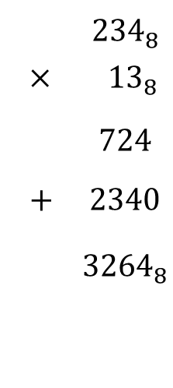
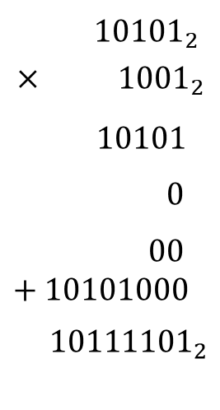
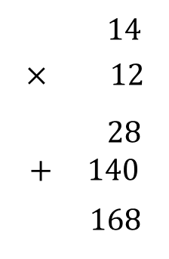
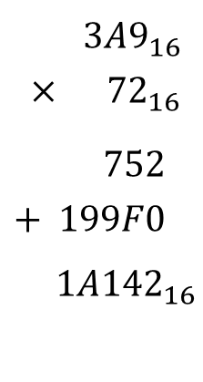
Multiplication
$14$
$$× 12$$
$28$
$+ 140$
$168$
${10101}_{2}$
$$× {1001}_{2}$$
$10101$
$0$
$00$ $+10101000$
$${10111101}_{2}$$
${234}_{8}$
$$× {13}_{8}$$
$724$
$+ 2340$
$${ 3264}_{8}$$
${ 3A9}_{16}$
$$× {72}_{16}$$
$752$
$$+ 199F0$$
$${ 1A142}_{16}$$

Slide 22
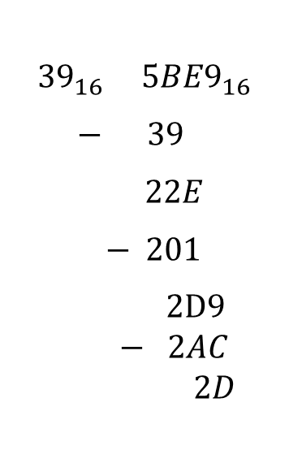







Division
$${39}_{16} {5BE9}_{16}$$
$− 39$
$22E$
$− 201$
$2D9$
$$− 2AC$$
$$2D$$
$$3 1562$$
$− 15$
$06$
$− 6$
$02$
$${11}_{2} {101001}_{2}$$
$− 11$
$100$
$− 11$
$101$
$$− 11$$
$$10$$
$${12}_{8} {3725}_{8}$$
$− 36$
$12$
$− 12$
$05$
$${19C}_{16} R2D$$
$$520 R2$$
$${ 1101}_{2} R10$$
$${310}_{8} R5$$

